Slide 1



Apple Sells Luxury, Not Just Products
Apple Stock prediction
Team 4
Members
SAIKRISHNA PAILA - G39129775
SIDDHARTH NADADHUR - G32021287
YASASWITHA GADDAM - G31728688

Slide 2

Abstract
The dataset provides a comprehensive view of Apple Inc.'s stock prices from July 1985, spanning 9,765 trading days, showing significant growth from cents to nearly $200. It also includes release dates for 21 iPhone models and 25 MacBook models, showcasing Apple's strategy of frequent innovation and renewal. Notable entries include transitions to in-house chips like the M1 and M2, highlighting Apple's shift towards self-reliance and strategic marketing of its innovations.

Slide 3

Problem Statement
The financial market is dynamic and subject to various influencing factors, making stock price prediction a complex yet crucial task for investors and analysts. In this project, we aim to develop a robust time series forecasting model for Apple's stock closing price from 1985 to 2024. To achieve this, we employ various models, each leveraging different approaches to capture temporal dependencies, trends, and patterns in the data.

Slide 4
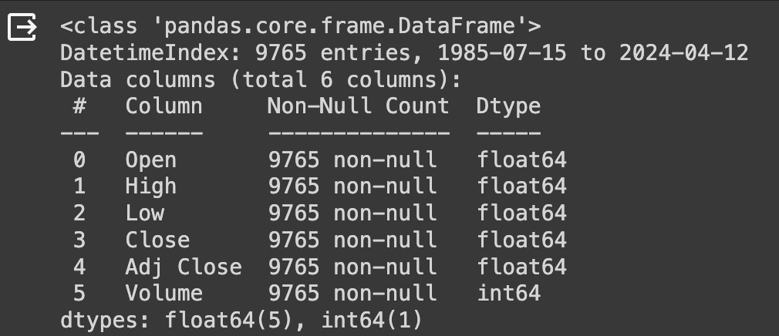
Dataset Info

Slide 5

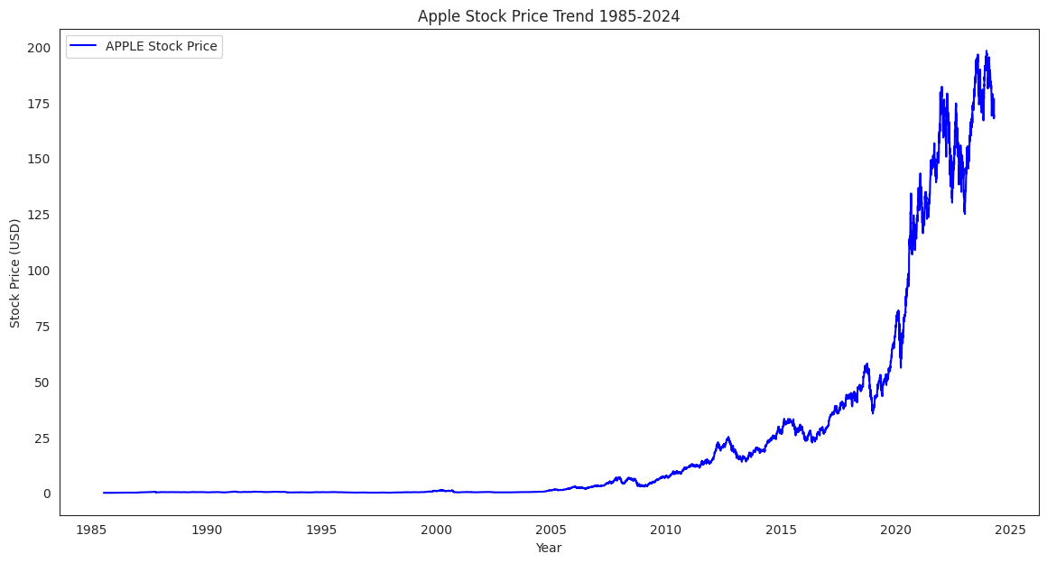

Exploratory Data Analysis

Slide 6
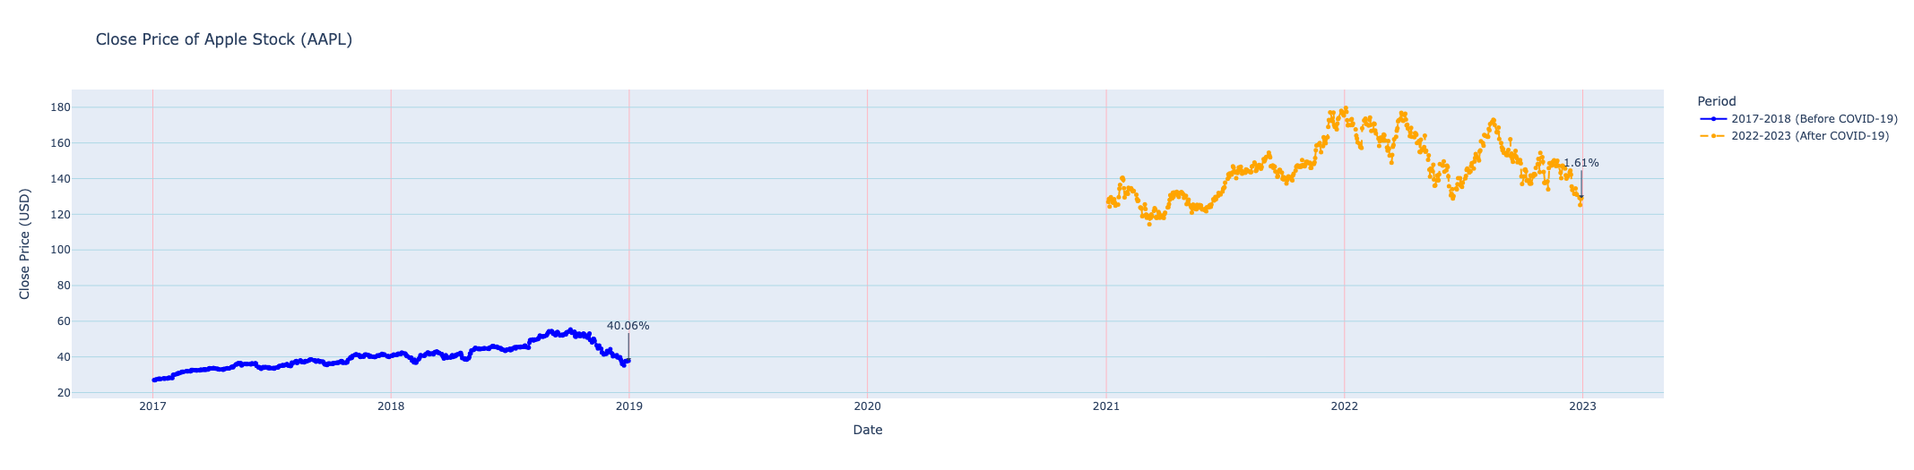
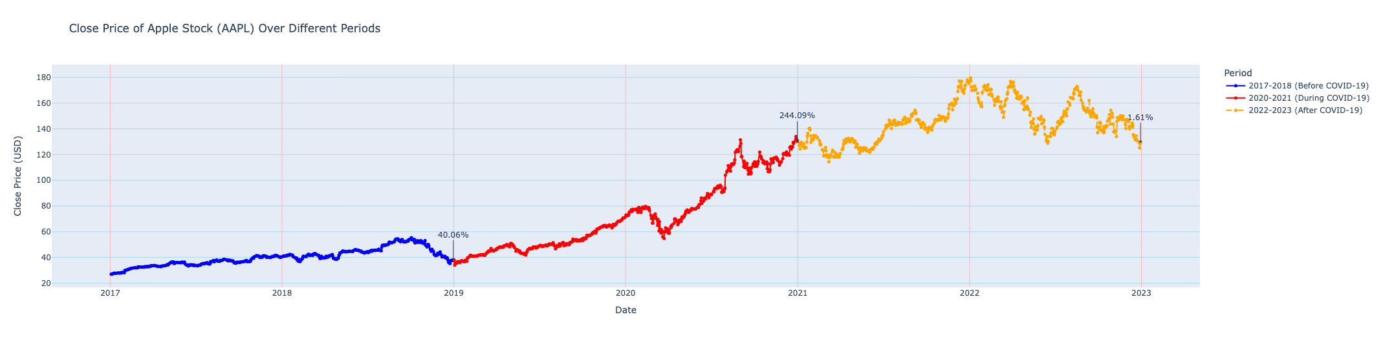
COVID-19 Impact on Apple Stock Price
Before COVID-19
After COVID-19
During COVID-19

Slide 7
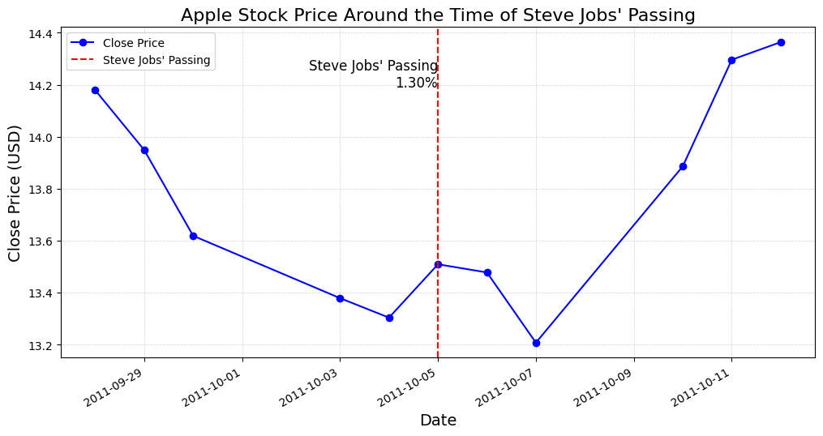
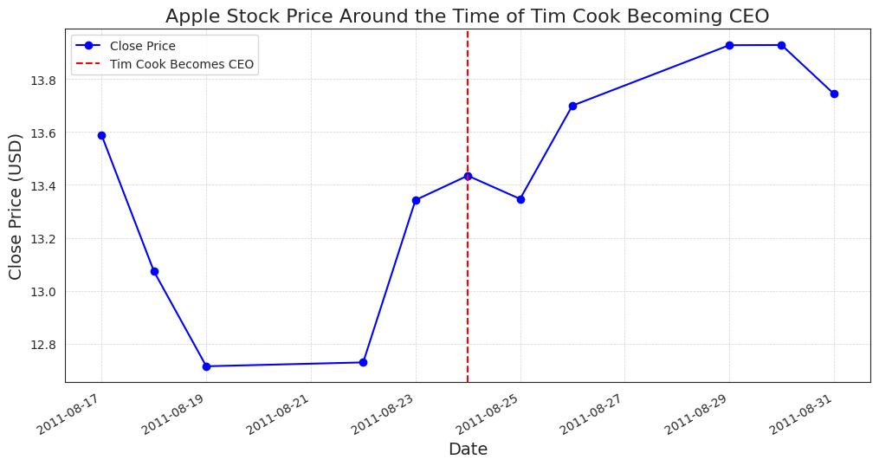
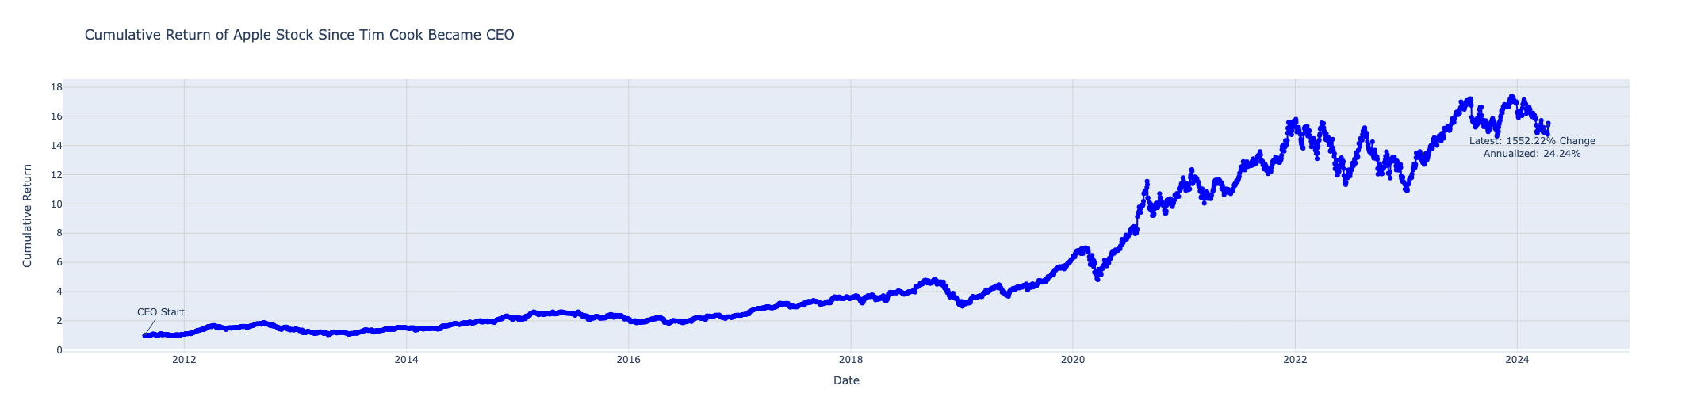
Evaluating Apple's Market Response to Executive Milestones"

Slide 8
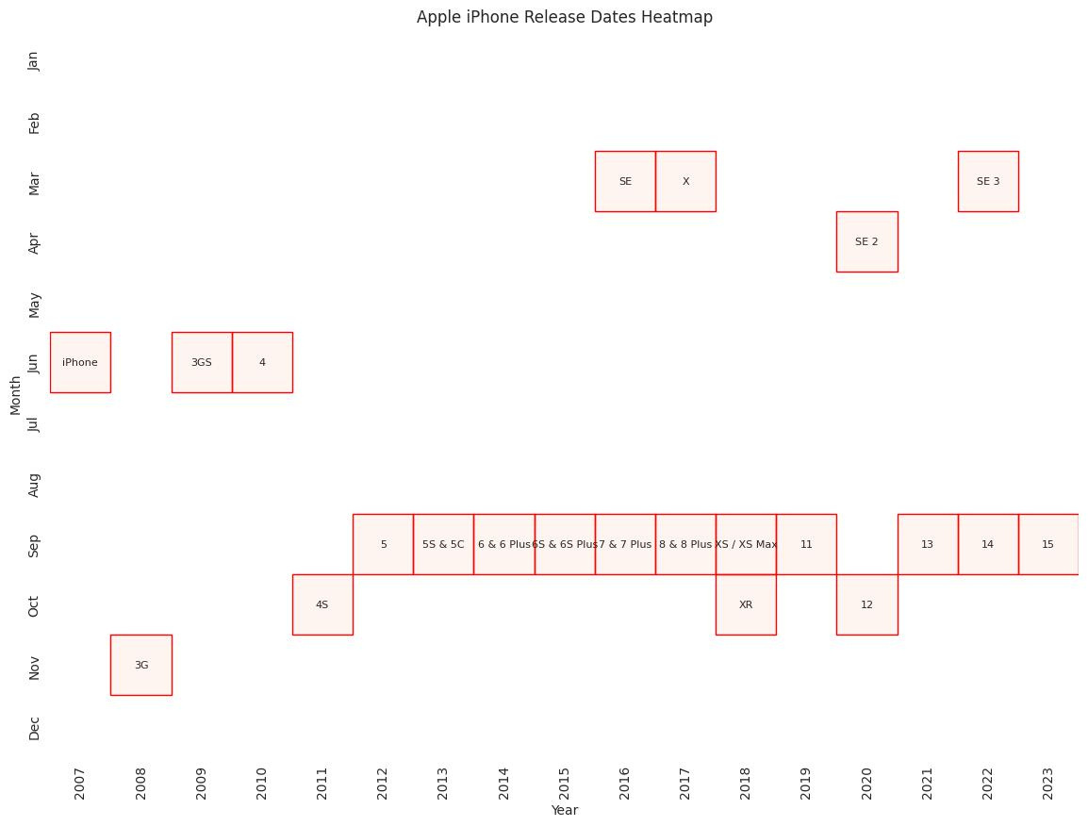

iPhone Releases Months

Slide 9

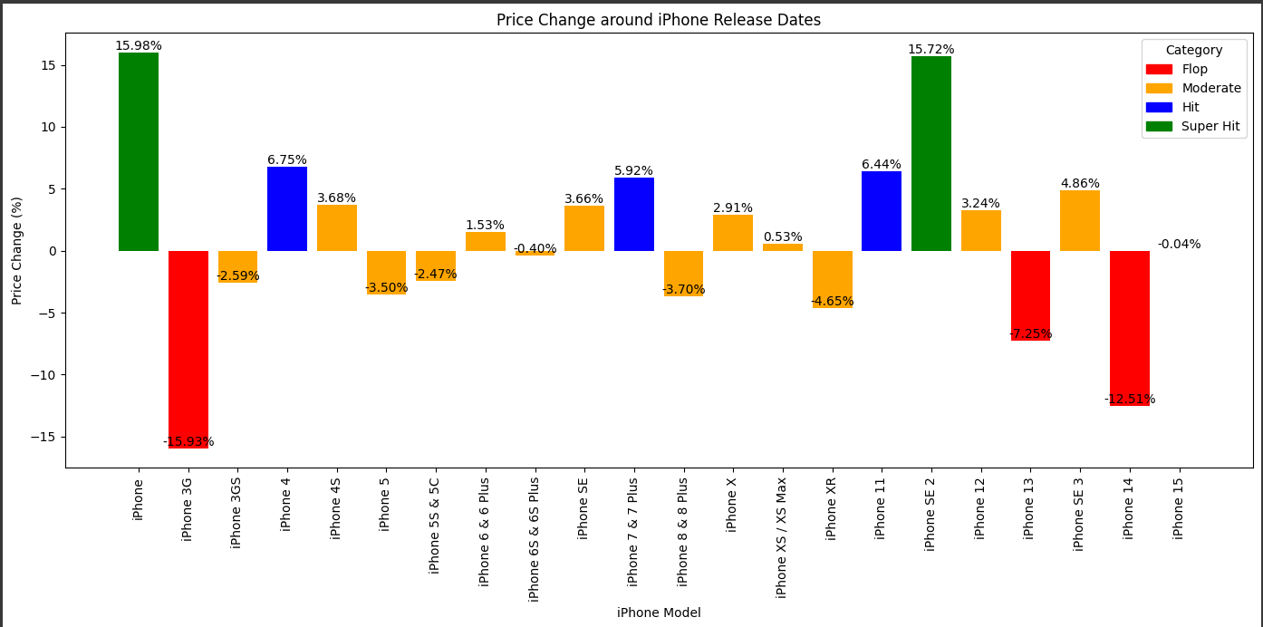
Market Reaction to iPhone Launches:
Performance Measured by Stock Fluctuations

Slide 10

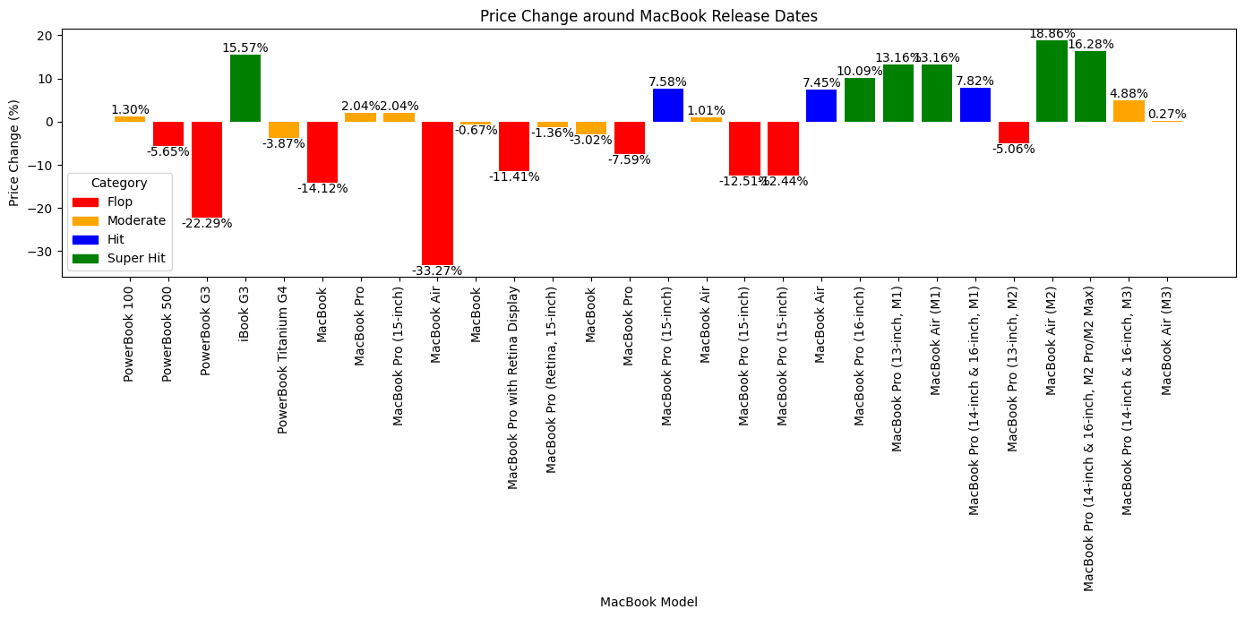
Categorizing Apple Stock Behavior in the Wake of MacBook Launches

Slide 11


Key takeaways from EDA
Apple's stock experienced significant fluctuations around the COVID-19 pandemic, with a notable decline followed by a volatile recovery period, reflecting market response to global events.
Major iPhone releases shifted from March to September after Steve Jobs' passing, aligning with the critical pre-holiday quarter to maximize consumer spending and market momentum.
Apple's stock prices have shown consistent and sharp increases since 2000, indicating sustained growth driven by the company's market presence and success.
The introduction of MacBook models featuring Apple's M1 chip, notably the MacBook Pro, influenced significant increases in Apple's stock value, reflecting market excitement for technological innovations.
Apple's stock tends to be higher from September to December and January to March, corresponding with periods of positive market sentiment and potentially influenced by holiday sales and new product releases, while experiencing lower levels in the mid-year
Analysis of iPhone releases indicates that models like the original iPhone and the iPhone 11 led to significant stock price increases ('Super Hits'), while models such as the iPhone 5C and the iPhone 12 resulted in declines ('Flops'), highlighting variations in market reception to product launches.

Slide 12



Key takeaways from EDA
Apple's stock tends to be higher from September to December and January to March, corresponding with periods of positive market sentiment and potentially influenced by holiday sales and new product releases, while experiencing lower levels in the mid-year.
Analysis of iPhone releases indicates that models like the original iPhone and the iPhone 11 led to significant stock price increases ('Super Hits'), while models such as the iPhone 5C and the iPhone 12 resulted in declines ('Flops'), highlighting variations in market reception to product launches.
Following Tim Cook's assumption of the CEO position, there was an immediate decline in Apple's stock price, reflecting market uncertainty or hesitation about the company's direction under new leadership. However, in the longer run, Apple's stock prices experienced significant growth, indicating restored investor confidence and approval of the strategic direction under Cook's leadership.

Slide 13




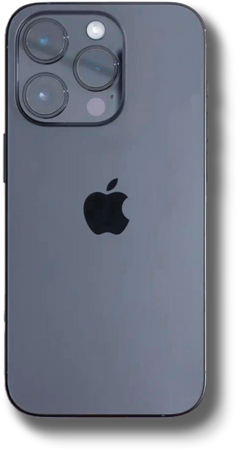

Model Building

Slide 14


Models Implemented
1. LSTM with XGBOOST & VOTING REGRESSOR
2. LSTM with lagged features & hyper parameter tuning
3. LSTM with TRANSFER LEARNING
4. PROPHET
5. LSTM without lagged features
6. ARIMA & SARIMA

Slide 15
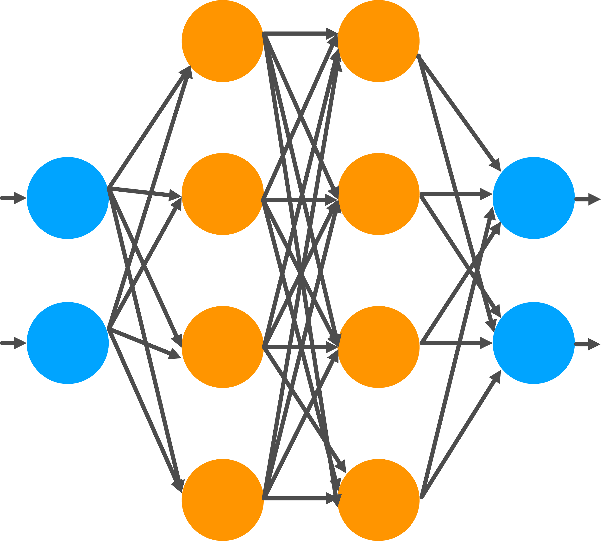
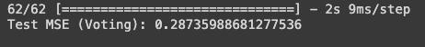

1. LSTM with XGBOOST & VOTING REGRESSOR
The architecture includes:
LSTM Model: A Sequential model comprising three LSTM layers, each with 50 units, and a Dense layer for output. This model captures time-dependent relationships.
XGBoost Regressor: A gradient boosting algorithm that provides robust predictions based on non-linear features.
Voting Regressor: An ensemble technique that combines the LSTM and XGBoost models via weighted voting, improving the predictive accuracy by aggregating their forecasts.

Slide 16

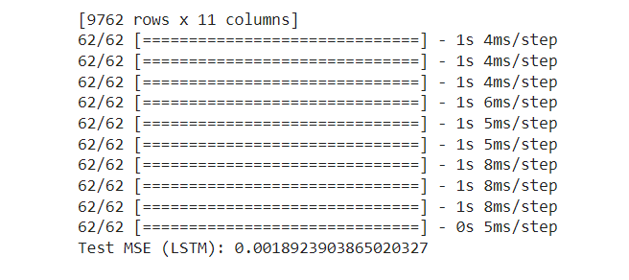
2. LSTM with lagged features & hyper parameter tuning
Features:
LSTM Architecture: The model consists of a single LSTM layer followed by a Dropout layer and a Dense output layer, designed to capture temporal patterns in stock data.
Lagged Features: To enhance forecasting accuracy, lagged features for the 'Close' price are added, providing context from previous time steps.
Parameters: The model undergoes manual hyperparameter tuning, experimenting with different values for LSTM units (50, 100, 150) and dropout rates (0.2, 0.3, 0.4).
Early Stopping: The training process includes an early stopping mechanism, monitoring validation loss and stopping if no improvement is seen after 3 epochs.

Slide 17

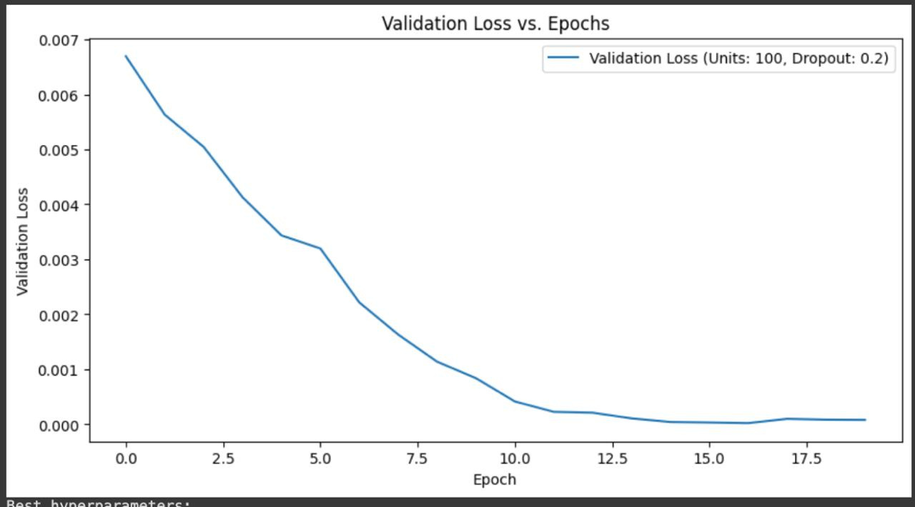

Validation loss vs epoch for LSTM

Slide 18

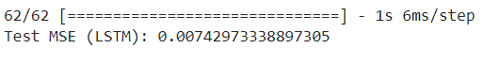


3. LSTM with TRANSFER LEARNING
Features:
Transfer Learning: The pre-trained LSTM model is reused and adapted through a multi-step process:
Initial Training: The model is pre-trained on the training dataset for 20 epochs with a dropout rate of 0.2, freezing all layers except the final Dense layer.
Transfer and Freezing: The pre-trained model is transferred, with all layers except the final Dense layer frozen, and further trained for an additional 10 epochs.
Fine-Tuning: All layers are then unfrozen for a second iteration of training to fine-tune the model, further improving its performance.

Slide 19

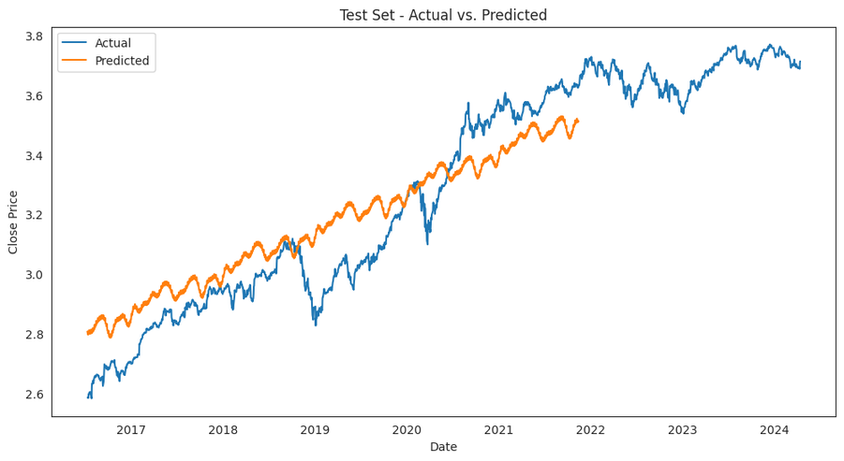
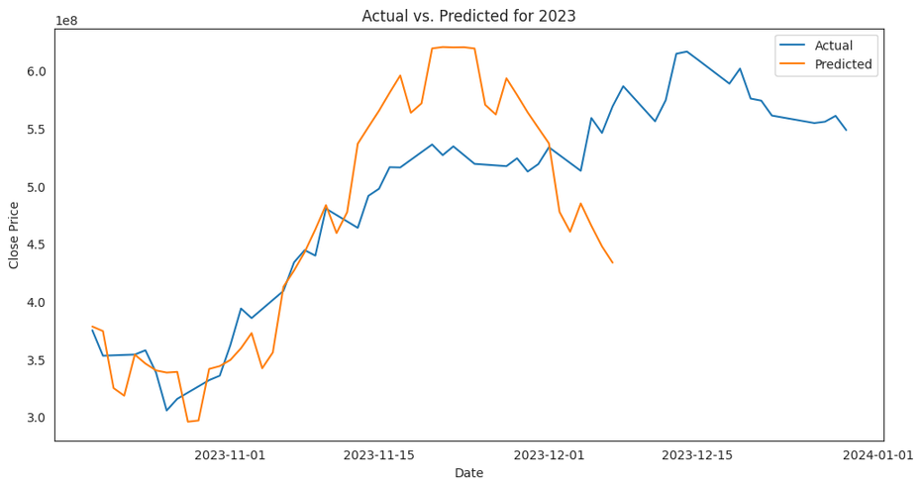

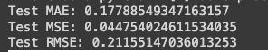
Timeseries Forecasting
1. PROPHET Model

Slide 20

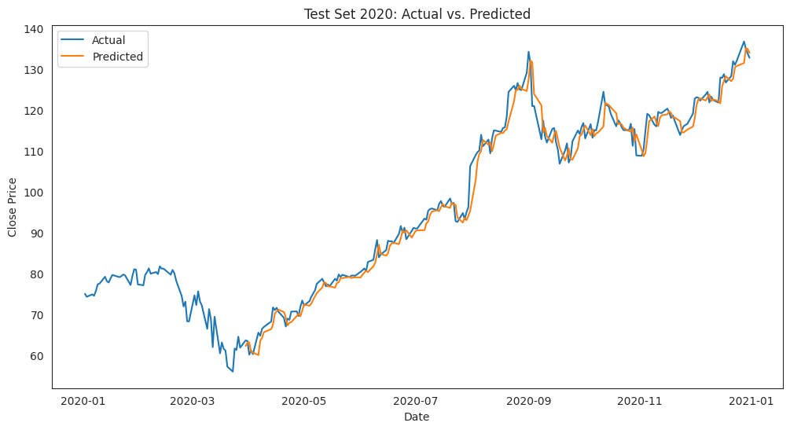
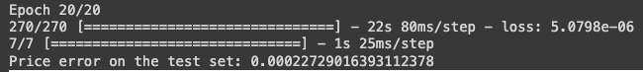
2. LSTM without lagged features

Slide 21

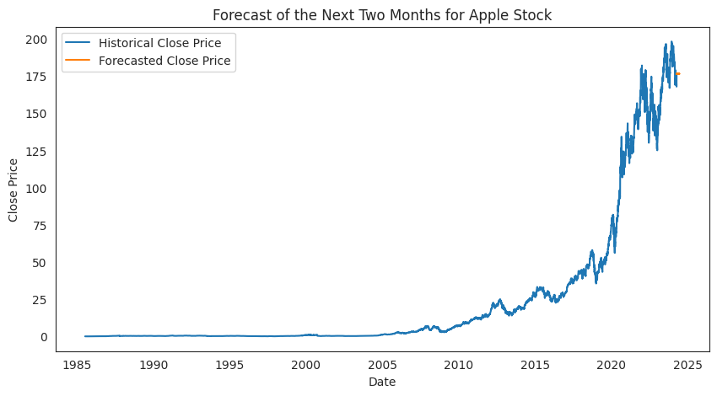
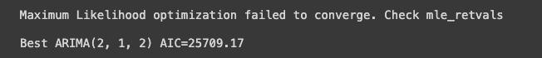
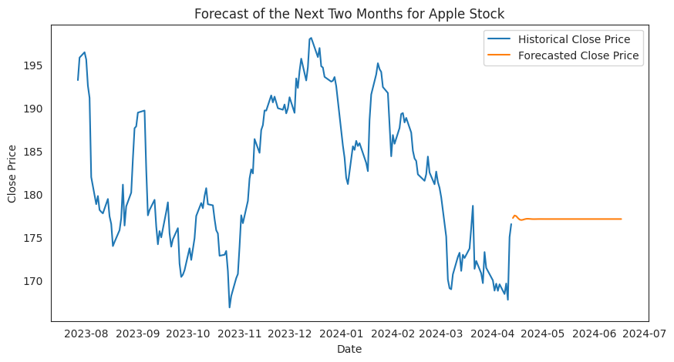
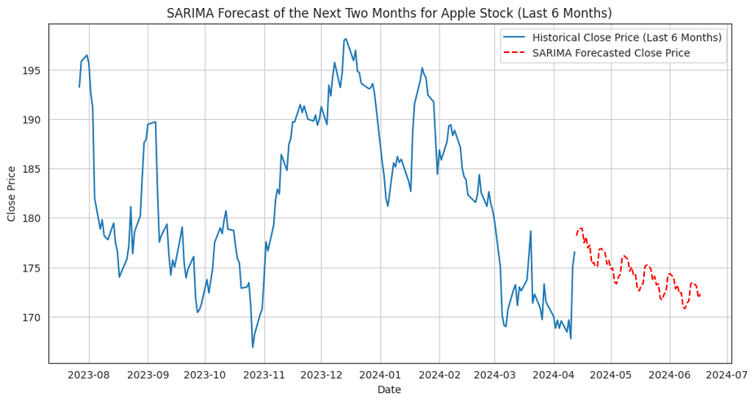
3. ARIMA & SARIMA

Slide 22

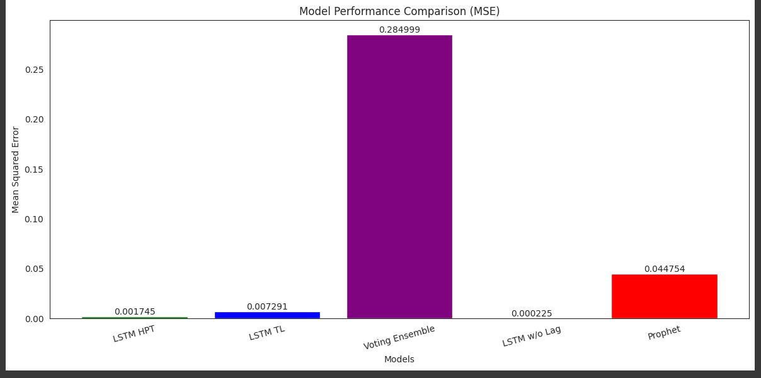
Model Comparison

Slide 23



